Slide 1
Government Contracting Must-Haves
Anna Urman, Director, Virginia PTAP
aurman@gmu.edu
Twitter @VirginiaPTAP Facebook: VirginiaPTAP

Slide 2
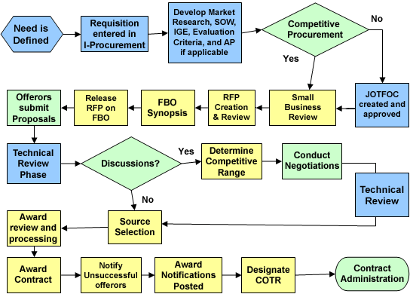
Procurement Process

Slide 3
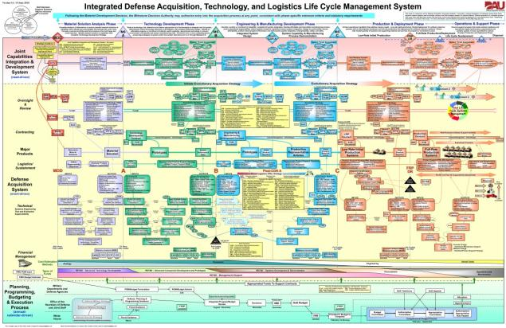
Integrated Defense Acquisition, Technology, and Logistics Life Cycle Management System
Not for the
Faint of Heart!
Link

Slide 4
Who are You?
Legal Requirements & Registrations

Slide 5
What Do I Need? (Registrations)
MUST HAVE
Nice to Have
Homework: NAICS, & PSC Codes
EIN # (Tax ID)
DUNS #
SAM.GOV
Get: CAGE Code
DSBS “Small Business” Profile
Preferences & Set-asides
Fbo.gov
Set up search agents
Agency-specific procurement sites
What else?

Slide 6
Preferences & Set-Asides: The Requirements

Slide 7
Presentation Essentials
Elevator Pitch | Pithy, ear-catching, leads to questions Tailored to audience What’s your goal
Business Card | Mini company bio Essential contact, socioeconomic info Appearances matter No hotmail, gmail, yahoo.
Capabilities Statement | Stylized, “pretty” & professional Relevant information Core Competencies = what do you do… well? Your relevancy / differentiators Tailor examples to audience tie together capabilities (technical) & customers = full picture Who you are (set-asides, etc) How to find you (Cage code, NAICS, Contracts)
Consistent
Professional
Tailored

Slide 8
WHAT Does Government Buy
Doing Your Homework

Slide 9
Past
www.usaspending.gov - obligations
www.fpds.gov – “Standard Reports”
ssq.gsa.gov – GSA Schedule Sales
www.gao.gov / trade press / strategic plans – reporting & performance
Present
www.acquisition.gov – Federal Acquisition Regulation
www.fbo.gov – opportunities, contact info for contracting officers
www.fedbid.com / www.fedconnect.net – reverse auctions
calc.gsa.gov – GSA rates
gsaelibrary.gsa.gov – GSA schedules
Itdashboard.gov – major IT investments
www.osdbu.gov – Office of Small & Disadvantaged Business Utilization
Future
https://www.acquisition.gov/?q=procurement-forecasts

Slide 10
Who are the people making buying decisions?
Contracting officers
“end users” – program managers, by any other name?
Influencers, bigwigs, and champions
Find out what you can – are they published? Do they speak at conferences? Are they on LinkedIn? Do they Tweet? Personal connections to them?
TALK TO THEM: Nobody likes to buy from strangers
Hint: listen to the industry “rumor mill” – networking events are great for that

Slide 11
HOW does Government Buy

Slide 12
Paths to Contract
“RFP” – the big money… and competition
Definitive contracts – customer knows what, when, how much
IDIQs / GWACs / MATOCs / GSA FSS Schedules
high potential “ceiling value”, no guarantee
Pre-negotiated “Ts & Cs”
Simplified Acquisition Process (SAP)
Small Business Set-Aside by default
$25,000 - $150,000 – written RFP, simplified process
$3,500 - $25,000 – NO WRITTEN RFP, 3 written offers
Under $3,500 – NO WRITTEN RFP, 3 oral offers
Reverse Auctions (often for SAP)
3rd party processors: Fedbid, Fedconnect
Lowest price

Slide 13
Competitive / Teaming Analysis
Who are the best vendors? (define “best”!)
And can you sub to them? If so, how do you stand out?
Who are other small businesses at the agency
Can you team? How are you better?
Who is the incumbent?
Is customer happy?
What are their prices?
check their GSA Schedule, FOIA their contract
What’s the current scope of work?
How big is their footprint – a one-off contract or embedded within agency? (Cut your losses!)
“If you don’t have a competitive advantage, don’t compete”

Slide 14
Are You Ready for Prime Time?

Slide 15
Walk the Walk & Talk the Talk
Demonstrate your knowledge
Your customer’s challenge
Their current environment/situation
Present a thoughtful, “tailored” solution
Hint: you don’t have to have it solved at the first meeting –
but ask the questions that will help you
Use the customer’s words – phrasing, deadlines, technical terms, jargon
Don’t expect instant deals
do expect long-term dialogue
Don’t waste time on folks who don’t buy what you sell

Slide 16
Next Steps?
Full training calendar: www.virginiaptap.org
Bid Match Service Subscription (110+ Federal, State, Local, International)
Free, confidential counseling
NEW to Counseling | Met with counselor before
Register as client www.virginiaptap.org Fill in profile COMPLETELY, with “E-Signature” Specify What Assistance You’re Seeking – so we can assign you to the right counselor A counselor will reach out (phone or email) to schedule a session | Call or email your counselor Don’t remember who it is? https://virginiaptap.org/about/staff/
Help with registration, counseling, classes – ptap@gmu.edu or 703-277-7750
Common topics
SAM/DSBS Certifications & set-asides: 8(a), EDWOSB, WOSB, VOSB, SDVOSB, HUBZone NAICS Codes State & Local (eVA, SWAM) | Capabilities statements Marketing to the government Market research Business development Proposals / RFP responses Security clearances | Compliance Teaming / subcontracting strategies GSA Schedules Pricing Contract management Contract performance

