Slide 1
SFDC Affordable Housing/Market Discussion
November 8, 2017
Presented by: Kyle Talente
RKG Associates, Inc.

Slide 2
Affordable Housing: “What is Affordable?”
There is a lot of confusion around the term “affordable”
Affordable:
Able to buy within one’s financial means
Reasonably priced
Within residential real estate, the concept is the same
A dwelling unit is affordable to those who can buy or rent within their means.
“Within One’s Means” and “Reasonably Priced” are the key to this discussion
The U.S. Department of Housing and Urban Development (HUD) defines affordable as paying at or below 30% of your gross income for housing
That means affordability is relative to income, not a standard

Slide 3
However, We Humans Need to Define Things
While affordability is relative to income, access to housing programs is not
Most communities define income requirements based on Area Median Income (AMI)
The Area Median Income for the Washington DC Metro area is:
$108,600 for a 4-perons household
$76,450 for a 1-person household
Fairfax County sets maximum income levels for its housing programs
Up to 50% for public housing
Up to 50% or 60% for Low Income Housing Tax Credit (LIHTC) units
Up to 60% or 70% for Affordable Dwelling Units (ADU), HOME fund units, Accessible units
Up to 70% for First Time Home Buyers program
UP to 70% or 80% for Magnet housing program units
Up to 80% for the Fairfax County Rental Program

Slide 4
Who Needs “Affordable” Housing?
“Affordable” Households
Rental (60% AMI)
Paralegals
Mental Health Worker
Custodian
Police Corporal
Ownership (80% AMI)
Teacher Assistant
Fire Fighter
Electrician
Landscape Architect
“Workforce” Households
Rental (80% AMI)
Teacher Assistant
Fire Fighter
Electrician
Landscape Architect
Ownership (120% AMI)
School Psychologist
Deputy Sheriff
Two Schoolteachers
Electrician AND Retail Manager

Slide 5
The Affordability Challenge: Renting
3-Person household income of $59,000 (60% of AMI)
$59,000 x 30% = $17,700
$17,700 / 12 months = $1,475 per month (rent and basic utilities)
Richmond Highway rents (www.apartments.com)
The Beacon at Groveton – Studios start at $1,456
Kings Garden – One bedrooms range from $1,355 to $1,395 (Two bedrooms start at $1,575)
Lafayette Apartments – One and two bedrooms below $1,475; three bedrooms over $1,600
$1,176 for a one bedroom and $1,410 for a two bedroom
There are committed Affordable Dwelling Units (ADU) units in new developments
Ranging from 6.25% to 12.5% of units in projects that take advantage of the County’s bonus density
Simply put, demand is substantially greater than supply for price points below 80% of AMI

Slide 6
The Affordability Challenge: Owning
Fairfax County’s first time home buyer program not a “given”
70% of AMI ($76,000 for 4-person household)
3% down payment, can qualify for a loan, have 1-months savings
Credit score of 640, no late payments for 6 months, no bankruptcy, no collections or judgements…
Very competitive (scoring and lottery system)
Can buy a home (townhouse or condo) between $95,000 and $195,000
1,437 units in Richmond Highway area (Census)
30 to 70 units on the market at any given time (typical market activity levels)
Simply put, demand is substantially greater than supply for price points below 80% of AMI

Slide 7
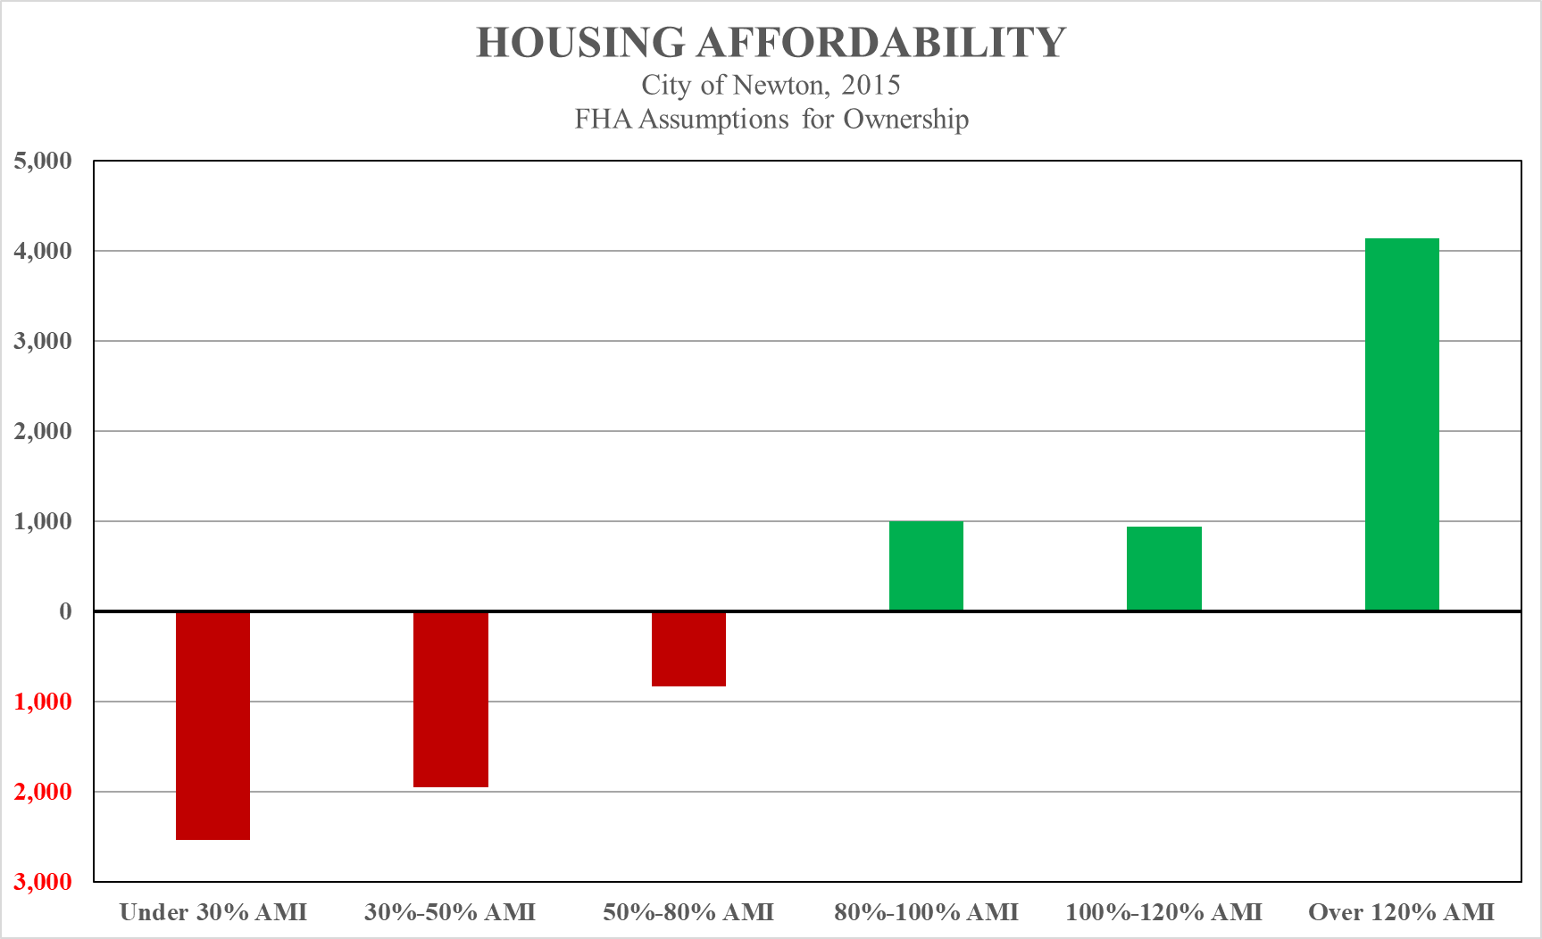
Source: RKG Associates, 2016

Slide 8
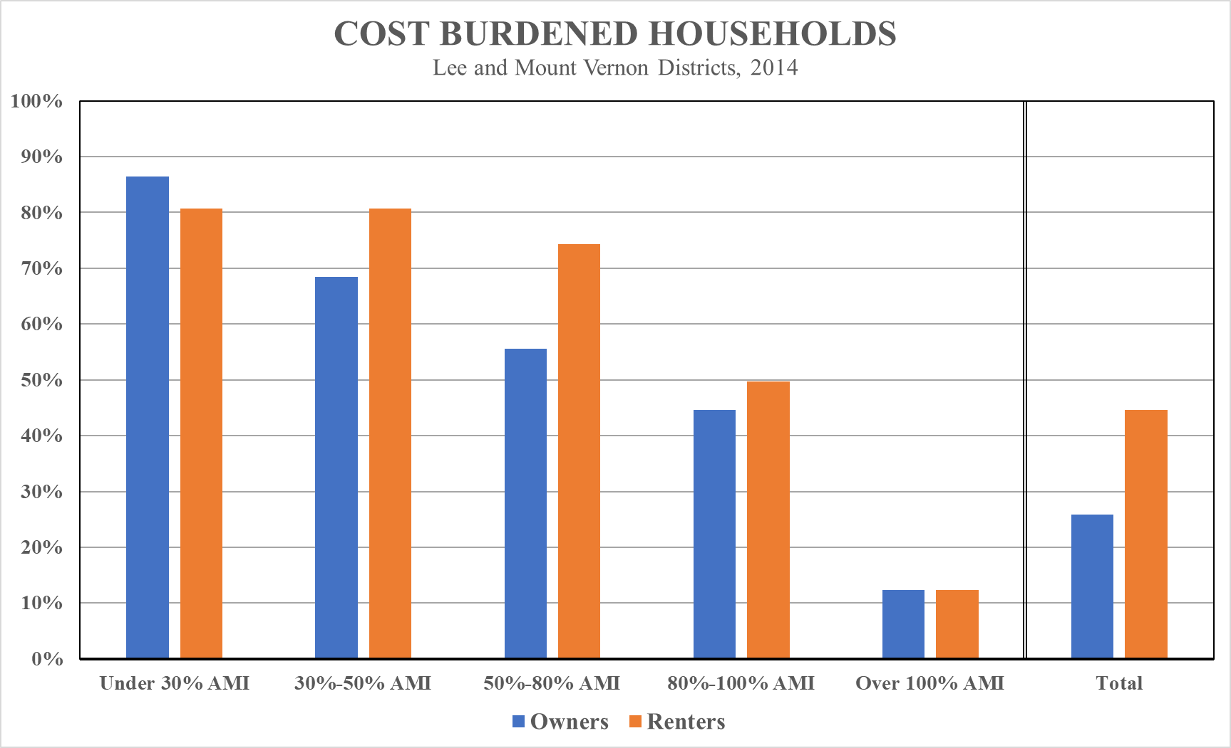
Source: HUD, 2017

Slide 9
The Affordability Challenge: Financial
Construction costs and market (controlled) rents are fixed
A brick is a brick is a brick
Market rents are based on supply and demand
The only variable in development is the cost of land
Reducing rents/asking prices substantially impacts profitability
Market rate about $2.00 to $2.50 PSF
Income controlled at 60% of AMI about $1.00 to $1.50 PSF
Loss of revenue enough to make projects infeasible
Studies have proven this throughout the DMV
Incentives/cost reductions necessary to bridge the gap
Financial, regulatory, procedural…

Slide 10
Source: RKG Associates, 2017

Slide 11
The Affordability Challenge: Policy
RECENT TAX POLICY PROPOSALS
Elimination of private activity bonds
Hurts state level bonding for affordable housing
Effects 4% LIHTC projects
Reduction of corporate tax rate
Diminishes value of (4% and 9%) tax credits without adjustments to LIHTC program
Historic tax credit program proposed for elimination
Rehabilitation/adaptive reuse for moderate income housing
New Markets Tax Credit program proposed for elimination
Investment in economically challenged areas
Limitation on mortgage interest deductions
Impacts affordability of homeownership
No guarantee any of these changes will be implemented
Uncertainty can be equally damaging to investment

Slide 12
Methods to achieve greater price diversity
Financial Tools
Tax abatements/TIF/PILOT
General fund investments
Dedicated tax millage
Housing contribution formulas
Regulatory Tools
Zoning districts/overlays
ADU/Bonus density
Parking easements
Preservation Tools
Demolition fees
Preservation incentives
Renovation loans/grants
Accessibility programs
Other Tools
Public land/colocation
PPPs
Expedited review
Financial education
Local housing vouchers

Slide 13
Benefits of housing diversity
Supports local economy
Richmond Highway has more than 36% employment earning less than $30,000
Substantially greater amount earning less than 100% of AMI
Improves housing choice
Millennials
Empty Nesters
Reduces cost burdening
67.8% of HHs earning less than 100% of AMI in Lee and Mount Vernon Districts are burdened
12.4% of HHs earning more than 100% of AMI are burdened
Enhances community
Increases long-term tenancy (leadership, investment, age in place…)
Reduces traffic

