Slide 1
Fairfax County FY 2019 Advertised Budget
The 2018 Economic Outlook Summit
Southeast Fairfax Development Corporation
April 12, 2018
www.fairfaxcounty.gov/budget

Slide 2
FY 2019 Advertised Budget Context
Focuses on priority requirements in FY 2019
Expands County and School cooperation and collaboration
Incorporates One Fairfax into decision-making process
Initiates multi-year strategic planning effort
Plan for FY 2020 and beyond
Continues to identify efficiencies
Lines of Business Phase 2, working in partnership with Schools
Joint Budget Workgroup
Expenditure trends

Slide 3
FY 2019 Advertised Budget Highlights
Recommended Real Estate Tax rate of $1.155 per $100 of assessed value – an increase of 2.5 cents
Projected value of “One Penny” in FY 2019=$24.64 million in revenue.
An overall increase for County and Schools of 4.38%
Fully funds School Board’s requested transfer after accounting for increased state revenues
Begins to address increased School capital needs with the assumption of an annual increase of $25 million in school bonds
Fully funds compensation for all County employees
Funds Board priorities such as Diversion First, Gang and Opioid Prevention Efforts, Early Childhood Initiatives, South County Police Positions
Net position increase of 77 County positions
Available balance of $3.88 million for the Board’s consideration

Slide 4
FY 2019 Advertised Budget Summary
With no change to Real Estate Tax rate:
Schools support would be reduced by more than $28 million from what is included in the FY 2019 proposal
The County’s Market Rate Adjustment would be partially funded at 1.26% (of the calculated 2.25%)
Limited funding would be available for Diversion First, Gang Prevention, Opioid Epidemic, South County Police Positions, School Readiness Initiatives, and other priorities
A 2.5 cent increase in the Real Estate Tax rate results in an increase in the average tax bill of approximately $268

Slide 5
FY 2019 Advertised Budget: Where It Comes From
FY 2019 General Fund Revenues
$4.29 billion
* For presentation purposes, Personal Property Taxes that are reimbursed by the Commonwealth as a result of the Personal Property Tax Relief Act of 1998 are included in the Personal Property Taxes category.

Slide 6
Annual Change in General Fund Revenue FY 2010 – FY 2020
Projections
* In FY 2017, without the 4 cent Real Estate tax rate increase, revenue would have been up 3.0%
** In FY 2019, without the proposed 2.5 cent Real Estate tax increase, revenue would be up 2.8%

Slide 7
Residential Market
Total increase of 2.17% in residential equalization
Average price of homes sold in CY 2017 was up 4.3%
The number of home sales rose 2.3%, from 15,755 homes in 2016 to 16,109 in 2017
Homes that sold in 2017 stayed on the market for an average of 45 days, down from 52 days in 2016
There are more than 342,000 residential properties in Fairfax County
Almost 65% saw an increase in assessed value
Last year, over half had no change or saw a decrease in assessed value

Slide 8
Annual Changes in Residential Equalization
Projection

Slide 9
Residential Equalization
Residential properties comprise approximately 73.8% of total base
Residential Equalization Percent Changes
Housing Type (Percent of Base) | FY 2014 | FY 2015 | FY 2016 | FY 2017 | FY 2018 | FY 2019 | FY 2020 Prelim
Single Family (71.7%) | 3.13 | 5.82 | 3.27 | 1.69 | 0.62 | 2.11
Townhouse/Duplex (19.8%) | 4.50 | 8.39 | 3.81 | 2.05 | 1.37 | 2.86
Condominiums (8.0%) | 5.42 | 10.51 | 4.48 | 0.73 | (0.32) | 1.68
Vacant Land (0.4%) | 2.89 | 3.38 | 3.03 | 0.92 | 0.03 | 2.01
Other (0.1%) | 4.74 | 3.42 | 2.56 | 6.42 | 9.52 | 9.70
Total Residential Equalization (100%) | 3.50 | 6.54 | 3.39 | 1.64 | 0.68 | 2.17 | 1.75

Slide 10
Nonresidential Real Estate
The amount of empty office space declined to 18.9 million sq. ft. out of 116.5 million sq. ft.
Office vacancy rates as of mid-year 2017
15.4% direct, down from 15.8% as of year-end 2016
16.2% with sublets, down from 16.8% at year-end 2016
Office real estate assessed values up after decreasing last year
Overall non-residential real estate values improved for a third consecutive year
Currently, over 3.1 million sq. ft. of office space under construction
More than 70% is already pre-leased or will be owner-occupied
Metrorail’s new Silver Line spurring new construction, including residential

Slide 11
Nonresidential Real Estate Revenue
Commercial/Industrial percentage of total real estate assessment base:
FY 2019 = 19.43%
FY 2018 = 19.12%
FY 2017 = 18.89%
FY 2016 = 18.67%
FY 2015 = 19.01%
FY 2014 = 19.96%
FY 2013 = 20.77%
FY 2012 = 19.64%
FY 2011 = 19.70%
FY 2010 = 22.67%
FY 1990 – Highest rate recorded of 26.76%
FY 1983 – Lowest rate recorded of 16.12%

Slide 12
Annual Changes in Nonresidential Equalization
Projection

Slide 13
Nonresidential Equalization
Nonresidential Equalization Percent Changes
Category (Percent of Base) | FY 2014 | FY 2015 | FY 2016 | FY 2017 | FY 2018 | FY 2019 | FY 2020 Prelim
Apartments (24.3%) | 4.90 | 3.59 | 1.20 | 2.92 | 3.37 | 2.40
Office Condominiums (3.7%) | (0.66) | (0.07) | 0.58 | 1.86 | 0.49 | 1.19
Industrial (6.7%) | 0.69 | 1.77 | 5.83 | 7.43 | (0.26) | 9.61
Retail (17.6%) | 1.18 | 1.52 | 2.46 | 1.60 | 7.39 | 7.00
Office Elevator (32.0%) | (2.41) | (2.93) | (4.67) | 3.42 | (1.39) | 2.82
Office – Low Rise (2.8%) | (1.72) | (2.41) | (5.00) | 1.73 | 1.39 | 1.11
Vacant Land (3.4%) | (0.74) | (1.19) | (4.62) | 1.50 | (1.17) | (0.35)
Hotels (3.3%) | (3.94) | (4.82) | 0.26 | 3.61 | (0.12) | 8.13
Other (6.2%) | 1.17 | 2.37 | 5.26 | 3.70 | 6.73 | 6.13
Total Nonresidential Equalization (100%) | 0.14 | (0.10) | (0.60) | 2.87 | 1.85 | 3.79 | 2.70

Slide 14
Real Estate Assessment Changes Mount Vernon District
Share of Total Assessments
Property Type (% Base) | FY 2016 (TY 2015) | FY 2017 (TY 2016) | FY 2018 (TY 2017) | FY 2019 (TY 2018) | FY 2015 to FY 2019
Residential (80.1%) | 3.48% | 2.41% | 0.58% | 2.31% | 9.03%
Nonresidential (19.9%) | 2.97% | 6.62% | 4.95% | 6.75% | 23.00%
Total | 3.38% | 3.16% | 1.39% | 3.16% | 11.55%

Slide 15
Real Estate Assessment Changes Lee District
Share of Total Assessments
Property Type (% Base) | FY 2016 (TY 2015) | FY 2017 (TY 2016) | FY 2018 (TY 2017) | FY 2019 (TY 2018) | FY 2015 to FY 2019
Residential (73.2%) | 3.78% | 2.18% | 1.73% | 3.11% | 11.23%
Nonresidential (26.8%) | 7.99% | 3.29% | 6.46% | -0.16% | 18.56%
Total | 4.85% | 2.48% | 2.98% | 2.22% | 13.10%

Slide 16
Real Estate Assessment Changes by Supervisor District
Property Type (% Base) | FY 2016 (TY 2015) | FY 2017 (TY 2016) | FY 2018 (TY 2017) | FY 2019 (TY 2018) | FY 2015 to FY 2019
Braddock
Residential (86.5%) | 4.46% | 2.02% | 1.93% | 3.08% | 11.98%
Nonresidential (13.5%) | 2.01% | 2.38% | 5.16% | 2.72% | 12.81%
Total | 4.13% | 2.07% | 2.36% | 3.03% | 12.09%
Dranesville
Residential (84.8%) | 4.07% | 2.40% | 0.78% | 3.24% | 10.88%
Nonresidential (15.2%) | -1.20% | 0.23% | 0.74% | 2.89% | 2.65%
Total | 3.21% | 2.06% | 0.77% | 3.19% | 9.55%
Hunter Mill
Residential (68.5%) | 3.47% | 1.85% | -0.17% | 2.04% | 7.35%
Nonresidential (31.5%) | 1.25% | 6.34% | 11.82% | 9.36% | 31.67%
Total | 2.87% | 3.06% | 3.15% | 4.23% | 13.98%
Mason
Residential (73.3%) | 5.12% | 2.67% | 1.90% | 3.24% | 13.54%
Nonresidential (26.7%) | 0.41% | 5.82% | 2.67% | 4.05% | 13.50%
Total | 3.86% | 3.49% | 2.10% | 3.45% | 13.53%
16

Slide 17
Real Estate Assessment Changes by Supervisor District (cont’d)
Property Type (% Base) | FY 2016 (TY 2015) | FY 2017 (TY 2016) | FY 2018 (TY 2017) | FY 2019 (TY 2018) | FY 2015 to FY 2019
Providence
Residential (50.8%) | 4.74% | 2.26% | 1.27% | 2.38% | 11.04%
Nonresidential (49.2%) | 3.11% | 8.90% | 3.70% | 8.17% | 25.95%
Total | 3.98% | 5.29% | 2.42% | 5.15% | 17.91%
Springfield
Residential (86.4%) | 2.80% | 2.07% | 1.11% | 2.83% | 9.09%
Nonresidential (13.6%) | 1.93% | 0.24% | -0.16% | 2.46% | 4.52%
Total | 2.68% | 1.81% | 0.93% | 2.78% | 8.45%
Sully
Residential (73.5%) | 3.65% | 2.05% | 1.23% | 2.47% | 9.73%
Nonresidential (26.5%) | 0.73% | 4.40% | 1.16% | 7.45% | 14.30%
Total | 2.90% | 2.64% | 1.21% | 3.74% | 10.90%
17

Slide 18
FY 2019 Budget Summary
 | COUNTY | SCHOOLS
Increased Revenues | $192.32
Transfer In Adjustment | $0.11
Available Resources | $192.43 million
Employee Pay | $49.96 | $86.90
Employee Benefits | $5.76 | $7.00
Debt Service/Capital | $3.02 | $6.75
Public Safety | $7.48 | --
Human Services | $8.78 | --
Community Development | $11.36 | --
Cost of County Operations | $1.75 | --
Reductions/Savings | ($3.40) | --
Enrollment and Other Requirements | -- | $21.65
Net Additional Schools Revenue | -- | ($27.20)*
Total Uses | $84.71 | $95.10
Combined Uses | $179.81 million
Revenue Stabilization | $1.67
Managed Reserve | $7.07
Reserve Requirements | $8.74 million
Available Balance | $3.88 million
Total available resources total $192.43 million
Schools support and County requirements are both increased 4.38% over FY 2018
Reserve requirements are based on Board policy guidelines
A balance of $3.88 million is available for the Board’s consideration in the adoption of the FY 2019 budget
* Includes $8.7 million in anticipated state revenue resulting from re-benchmarking and changes in Local Composite Index

Slide 19
FY 2019 Advertised Budget: Where it Goes
County Transit $36.2
Metro $20.7
Capital $18.5
IT Projects $4.8
Other $78.9
Fire & Rescue $209.4
Police $203.5
Sheriff $50.8
Other $46.7
Library $29.4
Parks $26.6
1.3%
Land Dev. Services $16.2
Planning & Zoning $11.6
Transportation $8.6
Other $17.3
Facilities Mgmt. $59.2
Other $19.6
11.9%
1.2%
3.7%
1.8%
0.9%
9.2%
Sheriff $20.0
Circuit Court $11.8
Other $8.3
2.0%
10.9%
Information Tech. $35.1
Tax Admin. $25.9
Finance $8.8
Other $15.3
Family Services $218.4
Community Services Bd. $135.4
Health $62.4
Neighborhood &
Community Services $31.1
Other $18.2
0.8%
3.5%
County Attorney $7.8
County Executive $7.1
Board of Supervisors $6.1
Other $11.8
FY 2019
General Fund Disbursements
$4.29 billion
52.8%
Operating $2,055.3
Debt Service $193.4
Capital $15.6

Slide 20
Initiatives Underway
Lines of Business, Phase 2
Work groups focused on program efficiencies to better address service needs
Updates by the end of the year
Multi-year fiscally constrained plan for Board priorities under development including, but not limited to:
Diversion First
Public Safety Staffing Plan
Human Services Resource Plan
IT Projects and process improvements, such as with the permitting process
Economic Success Strategic Plan initiatives including, but not limited to:
Fairfax First
Embark Richmond Highway
North Hill
Original Mount Vernon High School
Notes:
COUNTY

Slide 21
Fairfax First & Development Process Improvements
Multi-agency initiative to improve the speed, consistency and predictability of the county’s land development review process as part of the county’s Economic Success Strategic Plan.
With guidance from industry and senior county leadership, program teams, composed of county staff, community representatives and industry stakeholders, are implementing tactical recommendations for process improvements.
The recommendations focus on the following:
Instilling customer-centric, culturally integrated development services
Increasing collaboration and accountability
Reviewing and amending codes and ordinances to support modern development patterns
Integrating technology platforms to create seamless customer and staff interactions
Ensuring staff from all land development agencies have the tools and support they need to be successful
Notes:
COUNTY

Slide 22
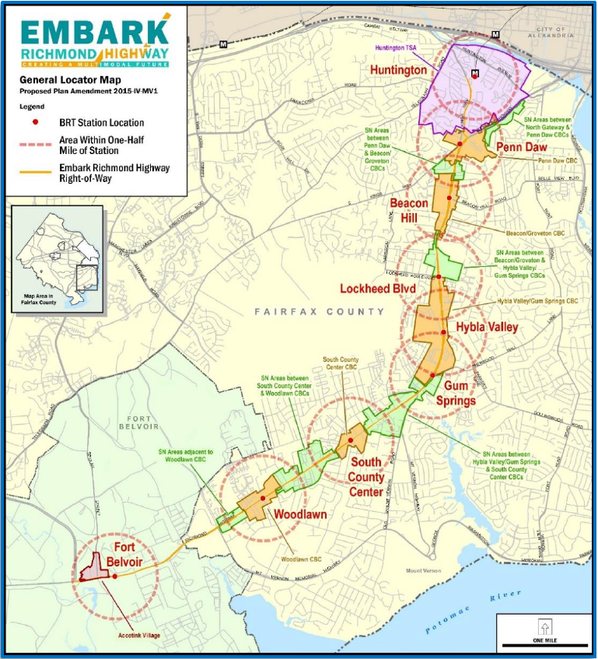
Embark Richmond Highway
Response to Route 1 Alternatives Analysis
Comprehensive Plan amendment
Corridor-wide goals and objectives
Multimodal Improvements
Bus Rapid Transit and future Metrorail
6-lane roadway with pedestrian, bicycle facilities
Land use within station areas
Urban design and other guidance
Extensive outreach and communication
Advisory group and greater community

Slide 23
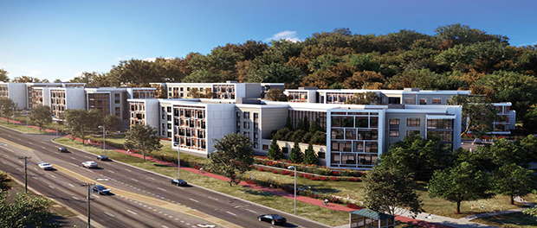
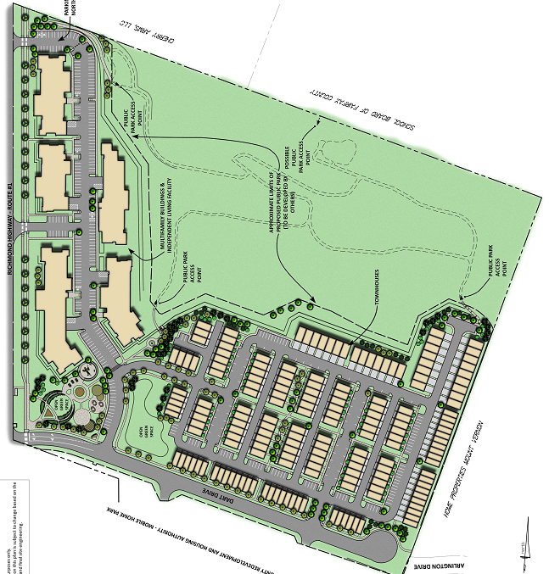
North Hill
Creating a high quality affordable mixed-income community
Public-private partnership to leverage existing FCRHA property for:
Up to 175 market rate townhomes
60 affordable independent senior units
219 affordable and workforce apartments
12 acre public park accessible to all members of the community
Site development planning underway
RZ approved February 2017
Low-income housing tax credits awarded in 2017by VHDA

Slide 24
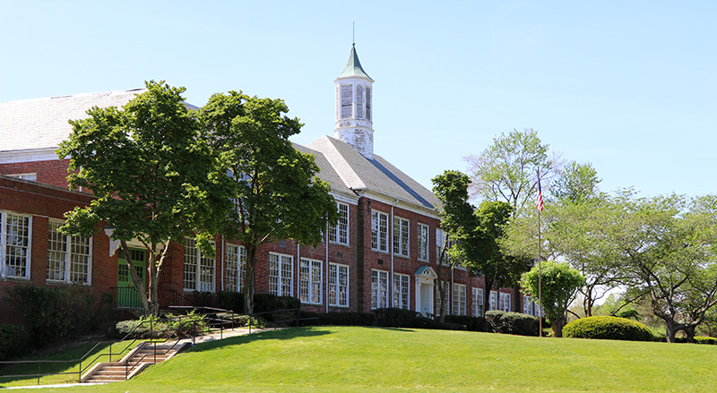
Original Mount Vernon High School (OMVHS)
Redevelopment of 42-acre school campus and George Washington park
Vision of a shared multigenerational, vibrant community amenity with residential, educational, and non-profit uses
Gym reopened for community use
Fire Marshal and FCPS registration spaces open
Master Plan activities underway with partners from The Alexander Company and Elm Street Development

Slide 25
Looking Forward
Restrained revenue growth anticipated for foreseeable future
Expenditure needs will continue to outpace resources – fiscal constraint will be required
Focus on Board priorities, balancing them against resources
Continued uncertainty about U.S. fiscal policy and impact of tax reform
Will continue to monitor State budget
Regional response to address ongoing Metro funding requirements

Slide 26
Looking Forward – continued
Committed to working collaboratively with Schools to meet joint priorities
Continue to identify efficiencies
Lines of Business Phase 2
Joint Budget Workgroup
Expenditure trends
Lay out multi-year strategic planning effort
Board, School and community partners engaged
In the context of One Fairfax

Slide 27
FY 2019 Budget Schedule
February 20, 2018 County Executive presents FY 2019 Advertised Budget Plan
February 27, 2018 Joint Board of Supervisors/School Board Budget Committee Meeting
March 6, 2018 Board of Supervisors advertises FY 2019 tax rates
March 20, 2018 Board of Supervisors advertises FY 2018 Third Quarter Review
April 10-12, 2018 Board of Supervisors holds Public Hearings on FY 2019 Budget, FY 2018 Third Quarter Review, and FY 2019-FY 2023 Capital Improvement Program
April 24, 2018 Board of Supervisors marks-up FY 2019 Budget, adopts FY 2019-FY 2023 Capital Improvement Program and FY 2018 Third Quarter Review
May 1, 2018 Board of Supervisors adopts FY 2019 Adopted Budget
May 15-16, 2018 School Board holds public hearings on FY 2019 budget
May 24, 2018 School Board adopts FY 2019 Approved Budget
July 1, 2018 FY 2019 Budget Year Begins

Slide 28
How to Become Involved
To sign up to speak at one of the public hearings, call the Clerk to the Board’s Office at (703) 324-3151, TTY (703) 324-3903 or to access the form to sign up to speak, go to:
www.fairfaxcounty.gov/bosclerk/speakers-form
The public can send written testimony or communicate with the Clerk’s Office by email at: clerktothebos@fairfaxcounty.gov
The entire FY 2019 Advertised Budget Plan and the FY 2019-FY 2023 Capital Improvement Program (CIP) are available online at:
www.fairfaxcounty.gov/budget

