Slide 1
Virginia Department of Small Business and Supplier Diversity (SBSD)
Selling to the Commonwealth
eVA and SWaM

Slide 2
Virginia Department of Small Business and Supplier Diversity (SBSD)
Our mission
To promote access to the Commonwealth of Virginia’s contracting opportunities and ensure fairness in the procurement process.
Notes:
2

Slide 3
Virginia Department of Small Business and Supplier Diversity (SBSD)
Our goals
increase the number of certified businesses in the Commonwealth
increase the total dollars allocated to SWaM vendors as a percentage of all discretionary spend or contract dollars.
Notes:
3

Slide 4
Selling to the Commonwealth
Step 1:
Register on eVA

Slide 5
What is eVA?
The tool used by the Commonwealth
for all
purchasing activity.
245+ state agencies, colleges & universities
770+ local governments
13,000+ eVA Users
Announce bidding opportunities
Get quotes
Place orders for goods/services

Slide 6
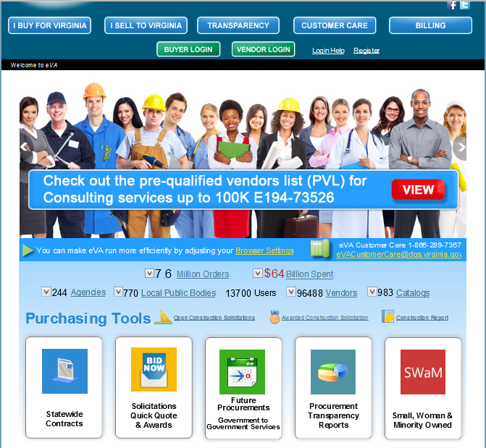
Get Registered - www.eVA.virginia.gov

Slide 7
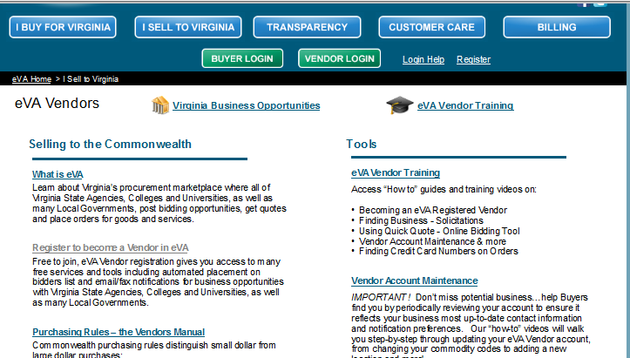
Get Registered

Slide 8
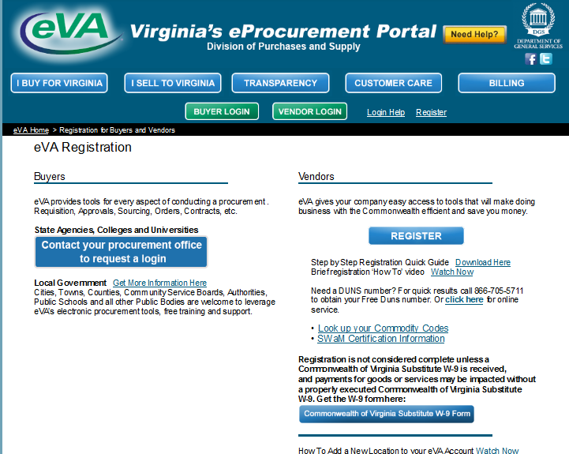
Get Registered

Slide 9
Get Registered
What you need to register…
Federal Tax Identification Number (TIN) – The 9 digit TIN or Social Security number that identifies your organization
DUNS number – Required for e-commerce. This free 9 digit number is issued by Dun & Bradstreet and identifies unique locations within a given company
Addresses and Contact information
Commodity Codes & Service Areas

Slide 10
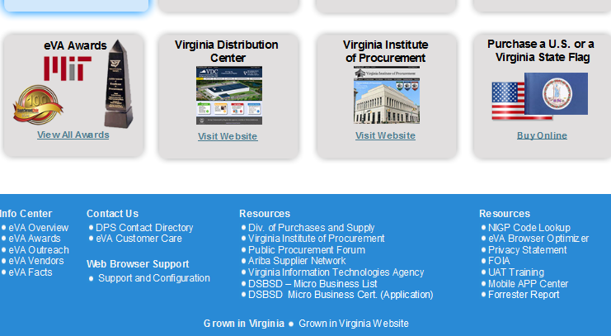
Find Your Commodity Codes Using the NIGP Look Up Tool
Access from the bottom of eVA website homepage

Slide 11
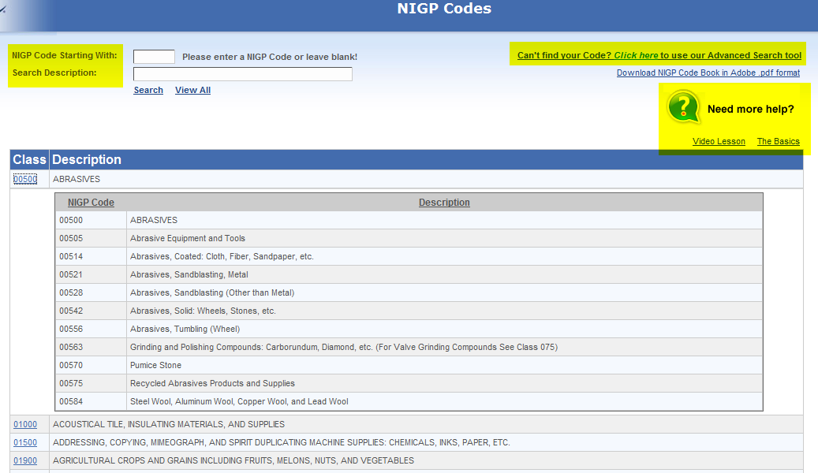
NIGP Look Up Tool
Commodity Codes
Describe your products/services
Tell eVA Buyers what you sell
Match you with bid opportunities

Slide 12
Need Help?
With eVA …
eVA Customer Care 1-866-289-7367
or
eVACustomerCare@dgs.virginia.gov
Online www.eVA.virginia.gov
eVA Order Terms
Vendor Manual
Vendor Resources
Tutorials & More!

Slide 13
Selling to the Commonwealth
Step 2:
Get Certified

Slide 14
Small, Women-owned and Minority-owned (SWaM) Certification
Small Business
At least 51% owned and controlled by one or more individuals who are U.S. citizens or legal resident aliens and together with its affiliates
No more than 250 employees
OR
No more than $10 Million in gross receipts averaged over the 3-year period prior to certification application.

Slide 15
Small, Women-owned and Minority-owned (SWaM) Certification
Micro Business
A certified Small Business under the SWaM Program
No more than 25 employees
AND
No more than $3 Million in average annual revenue over the 3-year period prior to certification application.

Slide 16
Small, Women-owned and Minority-owned (SWaM) Certification
Women-Owned Business
At least 51% owned and controlled by one or more women who are U.S. citizens or legal resident aliens
Minority-Owned Business
At least 51% owned and controlled by one or more minorities who are U.S. citizens or legal resident aliens

Slide 17
Small, Women-owned and Minority-owned (SWaM) Certification
Service-Disabled Veteran
A business that has been approved in the Service-Disabled, Veteran-Owned Small Business Program (SDVOSB) by the Virginia Department of Veterans Services
ESO
An organization that provides community-based employment services to individuals with disabilities that is an approved Commission on Accreditation of Rehabilitation Facilities (CARF) accredited vendor of the Department for Aging and Rehabilitative Services.

Slide 18
The SWaM Application Process
Go to: https://certification-app.sbsd.virginia.gov/
2. Create a user account then log in
3. Complete the online application for SWaM certification.
4. Upload required documents
5. Submit

Slide 19
The SWaM Application Process
Standard 60 BUSINESS days for processing once the application is complete.
Certification is good for 5 years.

Slide 20
Selling to the Commonwealth
Register on eVA
Get Certified

Slide 21
Virginia Department of Small Business and Supplier Diversity (SBSD)
Contact:
Chris Tran Ley
Business Services Manager, Northern Virginia
(804) 212-4647
chris.ley@sbsd.virginia.gov
www.sbsd.virginia.gov

