Slide 1
2019 Economic and Housing Outlook
Dr. Ralph B. McLaughlin
Deputy Chief Economist
April 11, 2019
Alexandria, VA

Slide 2
2019 Market Environment
Economic growth pushes unemployment rate down to 3.4%, lowest annual average in 66 years
Feds see a Goldilocks economy, mortgage rates hover just above historic lows
Dollar mortgage originations about the same as 2018, but home-price growth means loan counts down about 5% in 2019
Small rise in purchase originations in 2019
Drop in refinance; refi share forecast to hit 25-year low in 2019
HELOC for home-improvement up, HELOC for other purposes down
Affordability erodes; home-price growth forecast to slow
Price growth higher for lower-priced homes: for-sale supply limited
No national bubble, some metros ‘frothy’

Slide 3
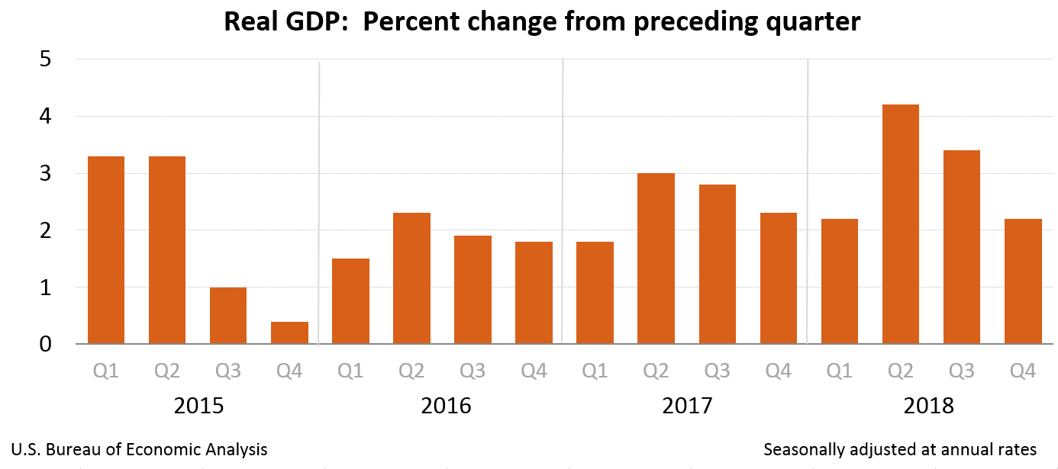

Slide 4
U.S. Economy Forecast to Grow 2.4% in 2019-When Will the Recession Hit?
In what year do you expect the next recession to begin?
Percent of respondents
2.4% economic growth in 2019 (IHS)
Expansion becomes longest in U.S. history in July 2019 (NBER)
20% 1-year recession probability (WSJ)
Most economists expect recession starts 2020 or later (NABE)
TCJA stimulus dissipates
Britain/Eurozone Troubles
Trade war uncertainty
Source: IHS Markit (GDP growth 2018 to 2019), Wall Street Journal Economic Forecasting Survey (November 2018), National Association for Business Economics Outlook survey (October 1, 2018), National Bureau of Economic Research

Slide 5
Fed Increasingly Focused on Inflation Risk
Feb 2019 Unemployment 3.9%, 49-year low
Forecast (IHS): 3.4% (2019 average)
Congressional dual mandate:
Maximum employment
Price stability
Unemployment rate 3.8% (MAR)
Hit Lowest Since 1969 in Oct
“Full employment”: 4.2-4.5%
Fed’s “price stability” definition:
2% annual (PCE)
Avg. inflation 1.9% since 2000
Feb. 2019: 1.5% annual
Fed raised fed funds target to 2.25-2.50% on Dec. 19
No increases in 2019
Maybe one in 2020
2019
3.4%
September 2018 Inflation At Fed’s 2% Target
Forecast (NABE): 2.1% (2019 Q4/Q4)
2019
2.1%
Source: BLS (unemployment rate), BEA (PCE price index), IHS Markit (unemployment forecast), NABE (PCE forecast)

Slide 6
2019 Mortgage Rate Forecast
Rates today at 4.1%; forecast to rise to 4.6% by Dec. 2019 & 4.8% by Dec. 2020
Interest Rate on 30-Year Fixed-Rate Mortgages
Source: Freddie Mac Primary Mortgage Market Survey®; forecast is an average of MBA, Fannie Mae, Freddie Mac, NAHB, NAR and IHS Market projections.

Slide 7
Slow Growth in Dollars Through 2020
Modest Rise this Year, Decline in Refinancing
Single-family Mortgage Originations (Billions of U.S. dollars)
MBA:
2018 to 2019:
Total: +3.2%
Refi: -1.5%
Purch: +5%
--Forecast--
Refinance
Purchase
Source: Originations for 2010-2017 are from CoreLogic public records (benchmarked to HMDA through 2017); 2018 to 2020 are an average of the latest projections released by Mortgage Bankers Association, Fannie Mae andFreddie Mac.. Originations exclude HELOCs.

Slide 8
Home-Price Growth Forecast To Slow in 2019
S&P CoreLogic Case-Shiller Home Price Index Growth for U.S. (annual, percent)
6.2%
4.3%
Forecast
3.3%
Source: CoreLogic Home Price Index and HPI Forecast for U.S. (March 26, 2018 release)

Slide 9
10 and 20 City Index Slowing Considerably
Source: S&P CoreLogic Case-Shiller Indices, not seasonally adjusted (March 26, 2019 release)

Slide 10
Costly Coastal Cribs Cooling
S&P CoreLogic Case-Shiller Index (percent growth, Jan. 2018-Jan. 2019)
U.S.
4.3%
Source: S&P CoreLogic Case-Shiller Indices, not seasonally adjusted (March 26, 2019 release)

Slide 11
Costly Cribs Cool
Source: S&P CoreLogic Case-Shiller Indices, not seasonally adjusted (March 26, 2019 release)

Slide 12
Price Pressures Rapidly Increase As Supply Drops Below 3 Months
San Jose
Premium
Percent Difference Between List Price and Sold Price
Discount
West Palm Beach
Atlantic City
Months' Supply
Source: CoreLogic
12

Slide 13
Inventory Tighter for Entry-Level Buyers
Months’ Supply by Price Tier
(July 2018 = 3.2 months)
Price Tier (Percent of Median Price)
Source: CoreLogic

Slide 14
Price Growth Strongest For Lowest-Priced Houses
Cumulative Price Growth Through August 2018 (percent)
Since August 2017
Since March 2011 Trough
Price Growth Since:
Source: CoreLogic HPI, Single-family Detached (October 2, 2018 release); National HPI trough occurred March 2011.

Slide 15
Single-family Rents Are Rising Too
Single-Family Rent Growth (annual percent change, January 2019)
Source: CoreLogic Single-Family Rent Index, August 2018

Slide 17
Source: HVS/CPS (February 28, 2019 release)

Slide 18
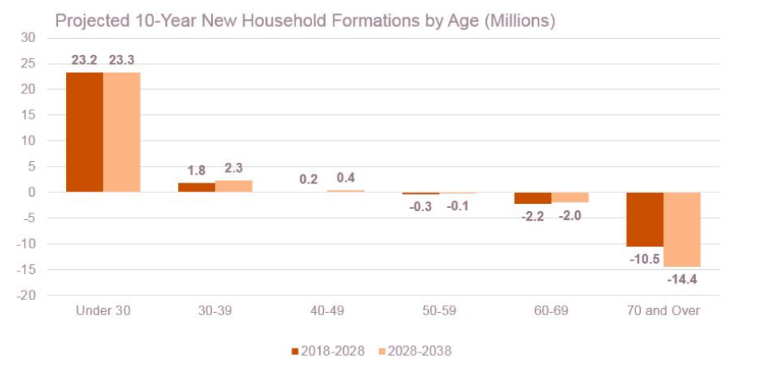
Young Household Growth Expected to Boom
Source: Joint Center for Housing Studies Household Projections, December 2018

Slide 20
Where to find more information
Look for regular updates to our housing forecast, commentary and data at
http://www.corelogic.com/blog
@CoreLogicEcon
@HousingRalph
The views, opinions, forecasts and estimates herein are those of the CoreLogic Office of the Chief Economist, are subject to change without notice and do not necessarily reflect the position of CoreLogic or its management. The Office of the Chief Economist makes every effort to provide accurate and reliable information, however, it does not guarantee accuracy, completeness, timeliness or suitability for any particular purpose.
CORELOGIC and the CoreLogic logo are trademarks of CoreLogic, Inc. and/or its subsidiaries.

